Slide 1

Lecture 6: IT in education
Hoger Mahmud

Slide 2



Lecture outline
Concept of education
e-Education
E-Education infrastructure
Software and hardware used in e-Education
Advantages of using IT in e-Education
2

Slide 3
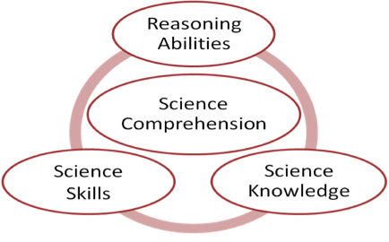
What is education
The process of receiving or giving systematic instruction, especially at a school or university
3

Slide 4
What is eEducation
The process of receiving or giving systematic instruction, using electronic means
eEducation
eLearning
eTeaching
4

Slide 5
E-education infrastructure
Mobile
(Cell phone) Technologies
CD –ROMs, DVDs etc
Networks
Telecommunication and TVs
e- education
Infrastructure
Internet Technology (computers, cellphones etc
Video-Conferencing
Radio communications
e-Learning Management Systems
5

Slide 6
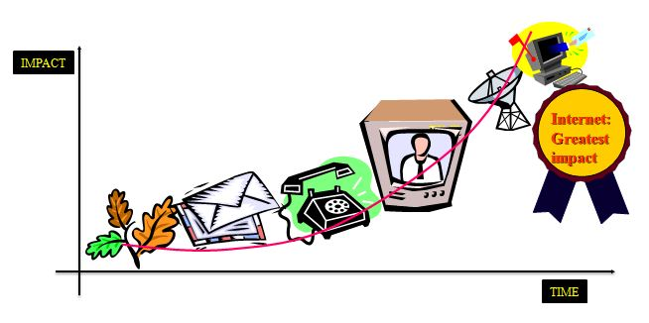
Evolution of education technology
6

Slide 7
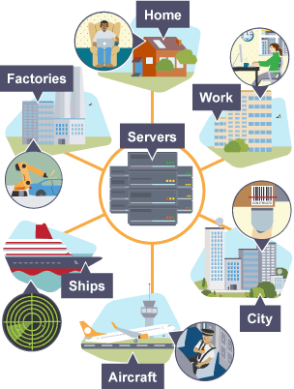
Education where and when you want
7

Slide 8
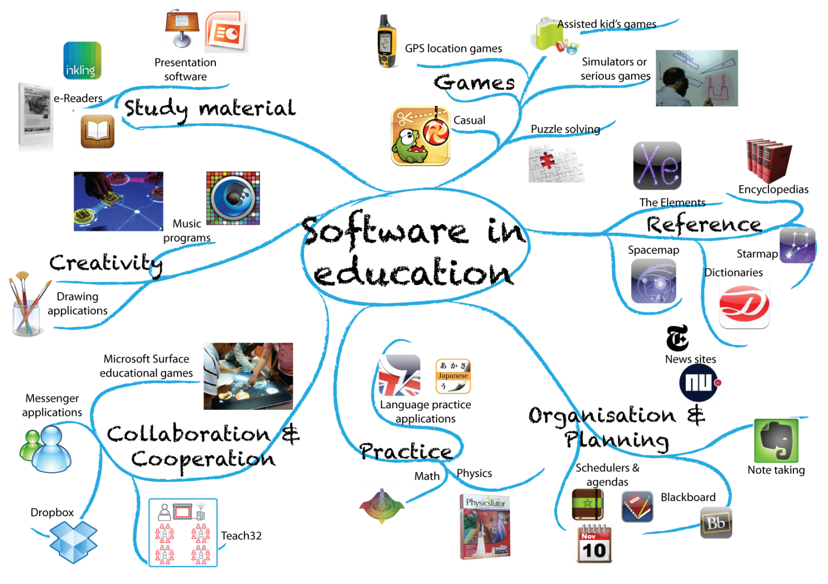
Software used in education
8

Slide 9

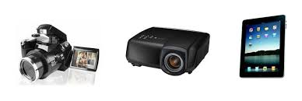


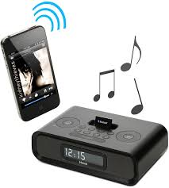


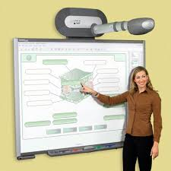
Hardware used in Education
Projector eBook reader digital writer
camera TV smart board
Video confrence sound and video player ipads
9

Slide 10
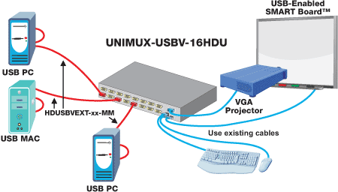
Example: Smart board system
10

Slide 11

Teachers Resource
Lesson Plans with clear objectives
e-Course Outlines
eActivities
eAssignments
Teachers’ Resources
Online Tutorials
eQuestions and equizes
e-Calendar
Internet Resources
1
Digital Journals
11

Slide 12
Benefits of eEducation
Learning is self-directed
Designed around the learner
Geographical barriers are eliminated, opening up broader education options
Learning is self-paced
24/7 accessibility makes scheduling easy
On-demand access means learning can happen precisely when needed
Travel time and associated costs (parking, fuel, vehicle maintenance) are reduced or eliminated
12

Slide 13

Thank you
?

